Slide 1


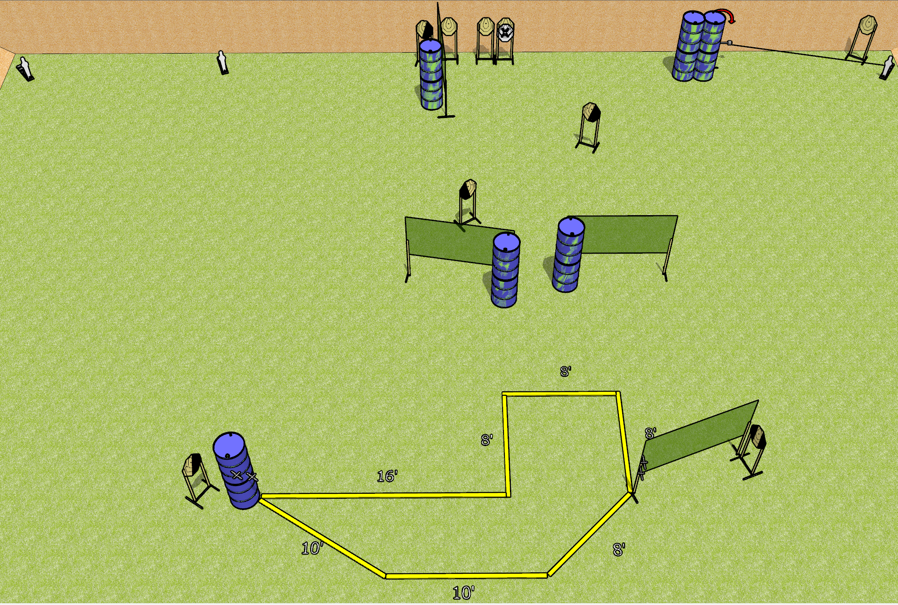
 | Dothan Gun Club – USPSA Match Shuffle Course Designer : Drew Coleman
Round Count 23 rounds 10 IPSC 3 mini poppers
Equipment List 8 wall feet Swinger + activator 1 left diag and 3 right diag, 1 tux

Slide 2
Shuffle
Written Stage Briefing
Shuffle is a 23 round, 115 point Comstock course of fire. There are 10 IPSC targets and 3 mini poppers. The best 2 hits on paper will score, and steel must fall to score. The start signal is audible.
The swinger is activated by the right mini popper and remains visible at rest.
Handgun start position is both hands touching either set of marks, feet completely outside the shooting area. Handgun is loaded and holstered.
PCC start position is muzzle touching any mark, stock on belt, feet completely outside the shooting area. Carbine is loaded, safety on.
On start signal engage targets as they become available from within the shooting area.

